Slide 1

May, 2025
A Sustainable Approach to Controlling Invasive Aquatic Species​
Project
MEGA
Monitoring and Predicting Water Hyacinth Growth Using Nano sensors​
-1-
Presented by Anouk Van Alphen
Gabriella Petersen
Sarbjit Singh
600725@student.belgiumcampus.ac.za
600850@student.belgiumcampus.ac.za
12303773@student.pxl.be

Slide 2
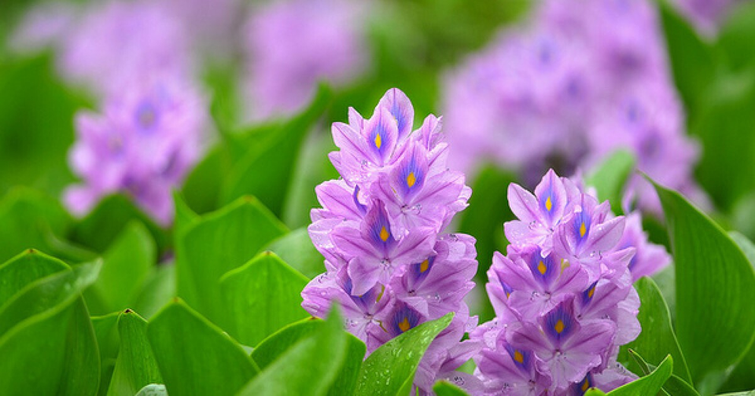

May, 2025
Statement
PROBLEM
Water hyacinth is an invasive aquatic species that thrives in nitrogen-rich environments
Causes:
Consequences:
Blocks sunlight & reduces oxygen
Agricultural runoff
Disrupts aquatic ecosystems
Sewage discharge
Breeding ground for mosquitoes
Industrial waste
Harms water quality, fisheries, and irrigation
-2-
Mega Project

Slide 3


-3-
May, 2025
OUR SOLUTION
Why it matters
A specialized dashboard built for environmental teams managing Hartbeespoort Dam, designed to:
Track nutrient level trends - simulated datasets
Current methods are temporary, costly, and labour intensive
No predictive system in place
There is a need for smart sustainable monitoring
Simulate alert scenarios based on nitrogen threshold breaches
Predict the likelihood of water hyacinth growth using machine learning models - using trained historical patterns
Not intended for public viewing or public engagement - technical interface designed specifically for operational use by individuals and organizations actively managing Hartbeespoort Dam

Slide 4





May, 2025
PROJECT
Plan
1
2
3
4
Phase 1
Phase 3
Development (Apr 7 – Apr 22):
Research & Planning (Feb 24 – Mar 10):
Phase 2
Built dashboard UI, integrated ML model, created alert logic using simulated data.
Studied water hyacinth causes, drafted project proposal, presented it for review.
Phase 4
Feedback & Refinement (Mar 17 – Mar 24):
Finalization (May 5 – May 28):
Participated in workshops, gathered mentor input, refined system scope
Tested full system, polished UI/UX, prepared demo & presentation.
-4-
MEGA PROJECT

Slide 5
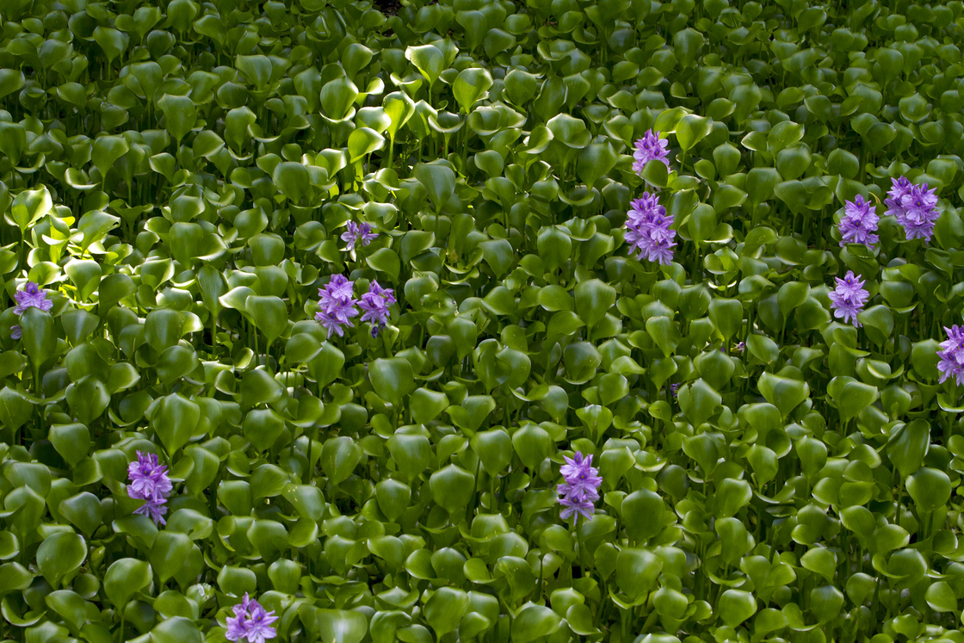

May, 2025
INNOVATION CONCEPTS
What Makes Our Project Different
Simulated Real-Time Data
We mimicked live sensor behavior using generated values — letting us build and test with no hardware.
Monthly Averaging for Clean Visuals
We used averaged data to reduce noise and provide clearer trend insights for dam-level monitoring.
Custom Thresholds
Users can set their own nutrient levels — making the system flexible, not one-size-fits-all.
Proactive Alerts
Our system alerts dam managers before visible hyacinth growth — enabling early intervention.
-5-
MEGA PROJECT

Slide 6

May, 2025
TECHNOLOGY APPLIED
Frontend
Database
Vue.js + Vite
Supabase (PostgreSQL)
Machine Learning
Supabase gave us a real-time-capable, hosted PostgreSQL database — great for simulating live sensor data and storing historical trends.
Deployment
We used Vue.js for a modular and reactive UI — perfect for real-time-ish data. Vite powered our dev server for ultra-fast builds and live previews.
Python + Jupyter Notebooks
Docker
We trained and tested our ML model using Scikit-learn in Jupyter — ideal for experimenting quickly and visualizing model results clearly.
We containerized our project with Docker to keep development clean and consistent. The app currently runs locally but is fully deployable to the cloud.
-6-
MEGA PROJECT

Slide 7
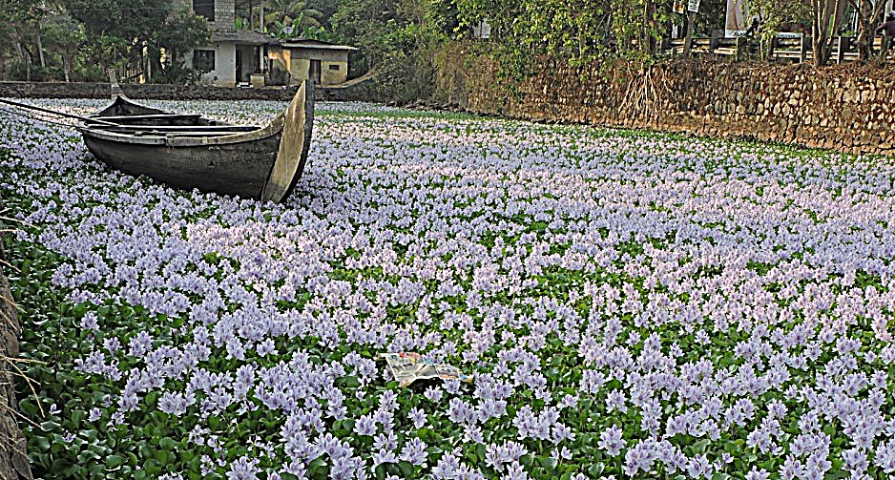

May, 2025
PRACTICAL
Demonstration
Show live demo
-7-
MEGA PROJECT

Slide 8






May, 2025
You
THANK
-8-
Presented by Gabriella Petersen
Anouk Van Alphen
Sarbjit Singh
MEGA PROJECT

